Slide 1
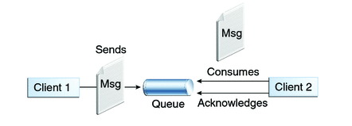

Spring + JMS + ActiveMQ Example with Annotations [Message Listener]
Queues [point-to-point]:
Queue’s are based on point-to-point messaging model where messages are sent to a queue.
Each message has exactly one sender and one receiver.
Message is guaranteed to be delivered to only one receiver.
SpringJMSProducer Application
SpringJMSConsumer Application

Slide 2
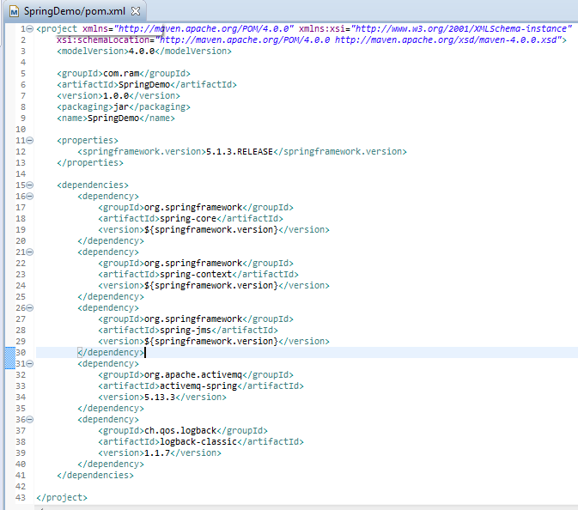
SpringJMSProducer Application

Slide 3
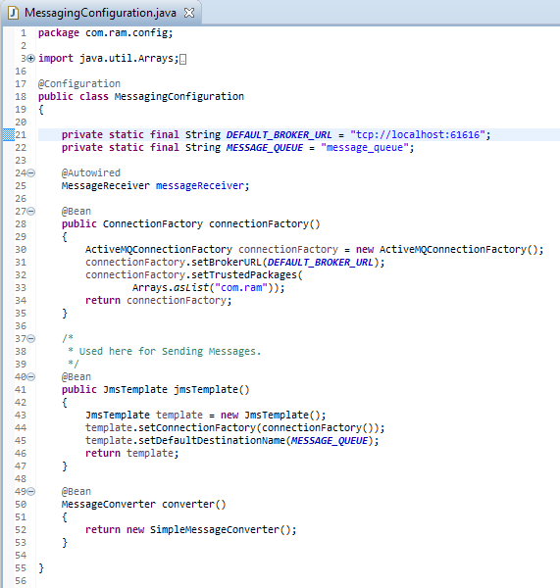
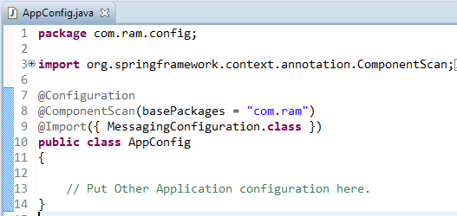
SpringJMSProducer Application
JmsTemplate : JmsTemplate provides an abstraction which hides all the complexities of JMS communication.
Without JmsTemplate, you will be forced to create connections/sessions/MessageProducers/MessageConsumers and catch all the nasty exception platform may throw.
With JmsTemplate ,you get simple API’s to work with , and spring behind-the-scenes take care of all the JMS complexities. It takes care of creating a connection, obtaining a session, and finally sending [as well as synchronous receiving] of message. We will be using JmsTemplate for sending the message.
Do note that JmsTemplate also provides possibilities for receiving message but that is synchronous[blocks the listening application], and usually not preferred when asynchronous communication is possible.

Slide 4
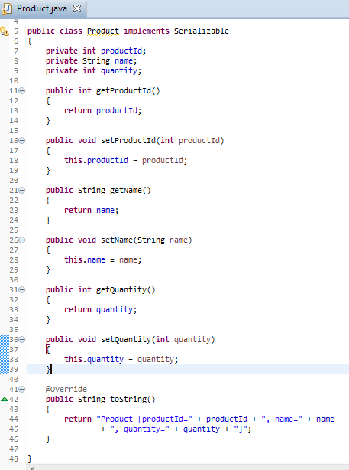
SpringJMSProducer Application

Slide 5
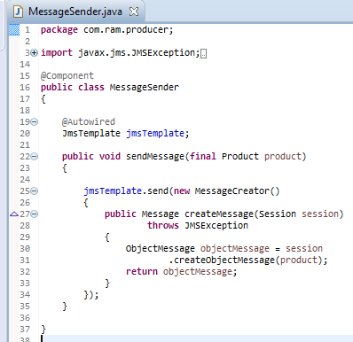
SpringJMSProducer Application

Slide 6
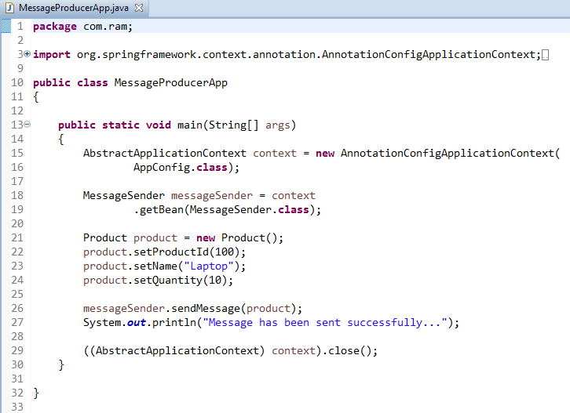
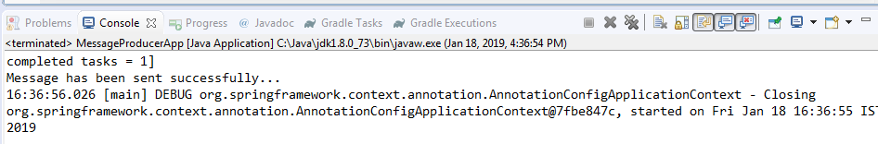
SpringJMSProducer Application

Slide 7
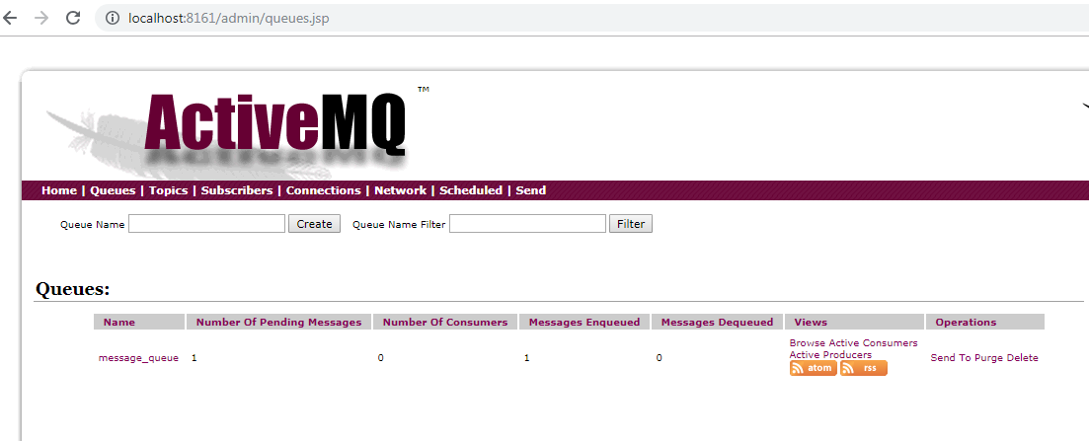
SpringJMSProducer Application

Slide 8
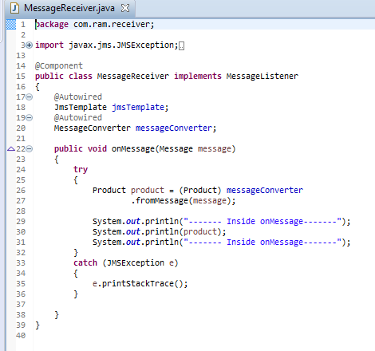
SpringJMSConsumer Application

Slide 9
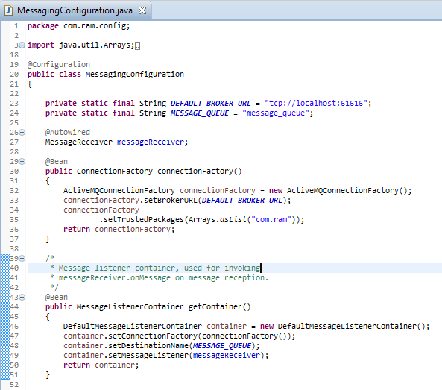
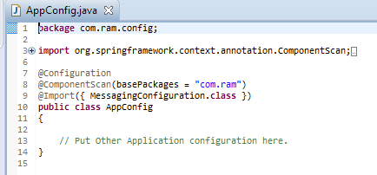
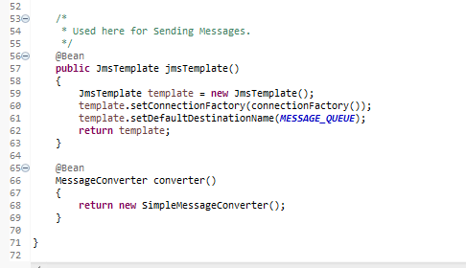
SpringJMSConsumer Application

Slide 10
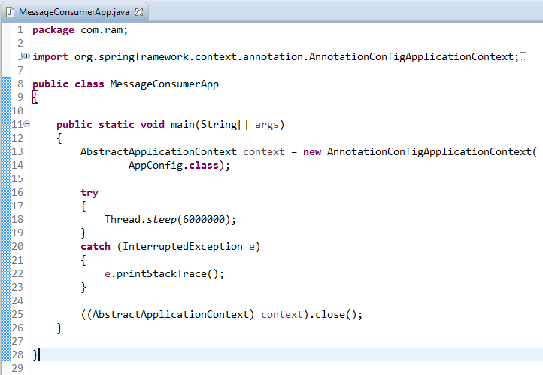
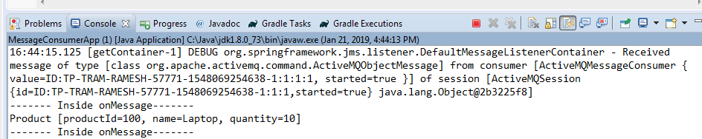
SpringJMSConsumer Application

Slide 11
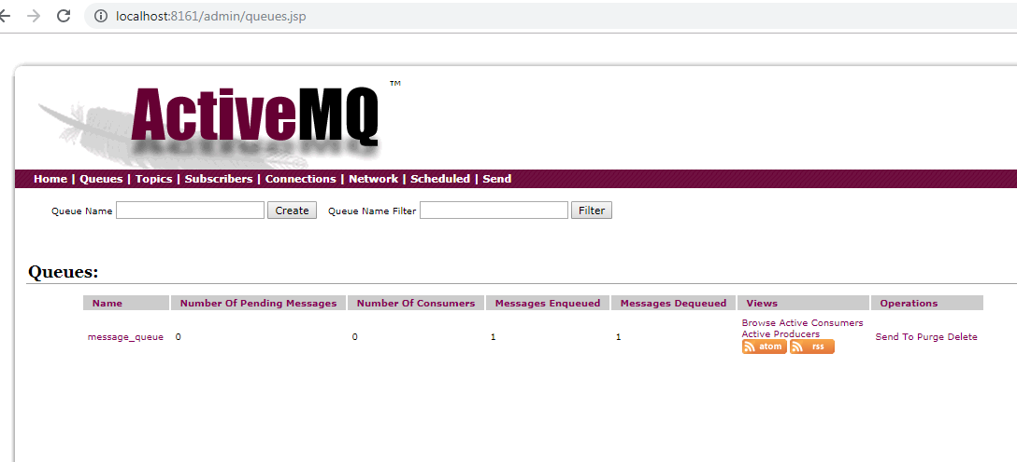
SpringJMSConsumer Application

